Slide 1









Praktikum Interaktive Machine Learning
AI in Finance
Andrii Koval, Yulia Khlyaka, Pavlo Mospan
10.02.2021 Augsburg

Slide 2
Purpose
create an interactive UI to predict the bitcoin price
find suitable models for timeseries forecasting
Methods: statistical models and neural networks

Slide 3
AI in Finance
“Bitcoin price prediction”
data set :
yahoo!finance
model:
ARIMA
Prophet
LSTM
UI:
Bokeh
Server:
Flask

Slide 4
ARIMA - SARIMAX
ARIMA - Auto Regressive Integrated Moving – Forecasting based on the presence of Tend
SARIMA – Seasonal Autoregressive Integrated Moving Average – Along with trend you have a presence of seasonality as well
An ARIMA model is characterized by 3 terms: p, d, q
where,
p is the number of autoregressive term
q is the number of lagged forecast errors in the prediction equation
d is the number of nonseasonal differences needed for stationarity
An SARIMA model is characterized by 4 terms: P, D, Q, s
where,
P is the order of the AR term
D is the order of the MA term
Q is the number of differencing required to make the time series stationary
SARIMAX = ARIMA + SARIMA
(p, d, q)(P, D, Q, m)
m is the number of time steps for a single seasonal period

Slide 5
Facebook Prophet
The Prophet algorithm is an additive model, which means that it detects the following trend and seasonality from the data first, then combine them together to get the forecasted values.

Slide 6
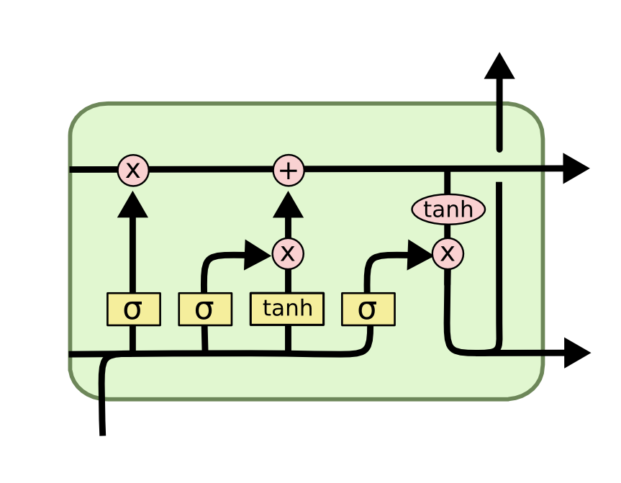
LSTM
Long Short Term Memory:
LSTM introduces long-term memory into recurrent neural networks
the previous information is used

Slide 7
conclusion
ARIMA |  | Prophet |  | LSTM
+ Simple to implement + can predict small ups and downs well + forecasts are usually more accurate and reliable | If there is an unusual growth or slowdown in the series ARIMA fails it forecast well for short run doesn’t do well with limited data | + fast + completely automated + robust to missing data and shifts in the trend + It works well with at least one year of historical data. | Limited hyperparameter adjustment doesn’t do well with limited data less accurate forecast | + can solve the vanishing gradient problem + capable of retaining memory for a longer duration of time + small number of parameters | They require a lot of resources and time prone to overfitting No pre-requisites (stationarity, no level shifts) Needs a lot of data

Slide 8
Root Mean Squared Error
Root Mean Squared Error
ARIMA: 508.94965228374423
Prophet: 1786.1781454204304
LSTM: 424.92938066897835

Slide 9

Vielen Dank für Ihre Aufmerksamkeit!
Andrii Koval, Yulia Khlyaka, Pavlo Mospan
Multimodale Mensch-Technik-Interaktion
Universität Augsburg
www.uni-augsburg.de

